Slide 1

Unified Data Platform: University data management
BUAN 6335.501 Final Group Project
Group # : 5

Slide 2
Objective: A unified data-driven architecture
Common Data Platform
Seamless data integration
Single Source of truth
Master data management
Unified Data Store for analytics
Data analytics governance
Analytical data models
Predictive analysis using AI

Slide 3
Data sources
Batch processing:
Student Data
Faculty and Staff Data
Administrative Data
Course and Curriculum Data
Research Data
Library Data
Event and Calendar Data
Infrastructure Data
Learning Management System (LMS) Data
Real time processing:
Sensor Data (if applicable)
External Data
User Interaction Data
Communication Data
Biometric Data (if applicable)

Slide 4
Solution roadmap
A data lakehouse architecture
Hybrid approach (Data sources partly on-prem)
Cloud native solution with a data migration strategy
Addressing bottlenecks
Optimization solutions
Implementation plan and cost estimation
AI/ML use cases

Slide 5
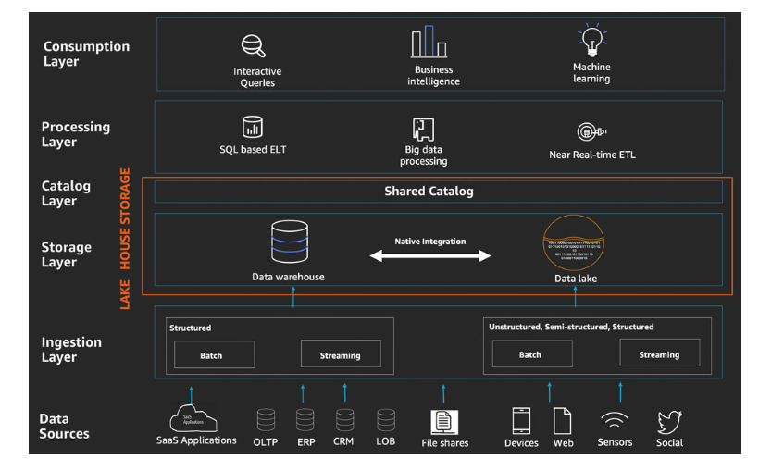
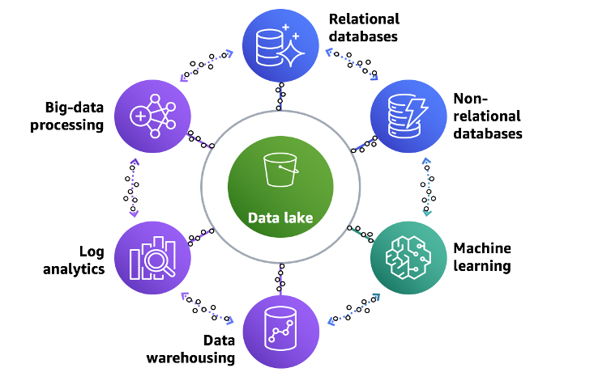
The Data Lakehouse approach

Slide 6
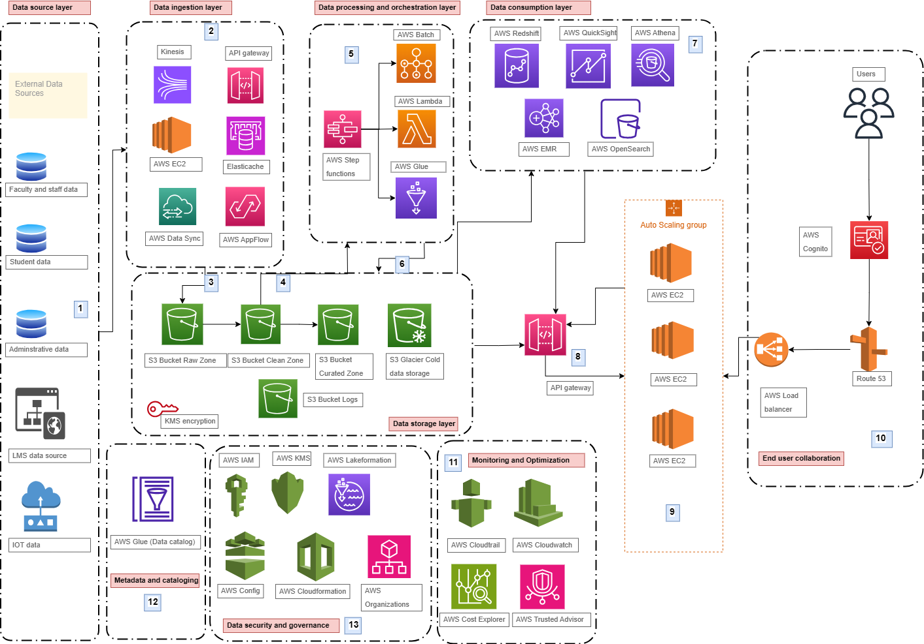
Hybrid solution: Architecture

Slide 7
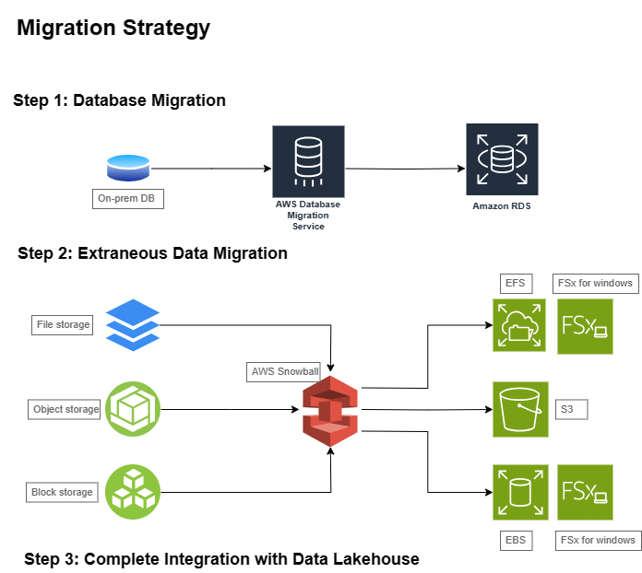
Cloud solution: Migration plan

Slide 8
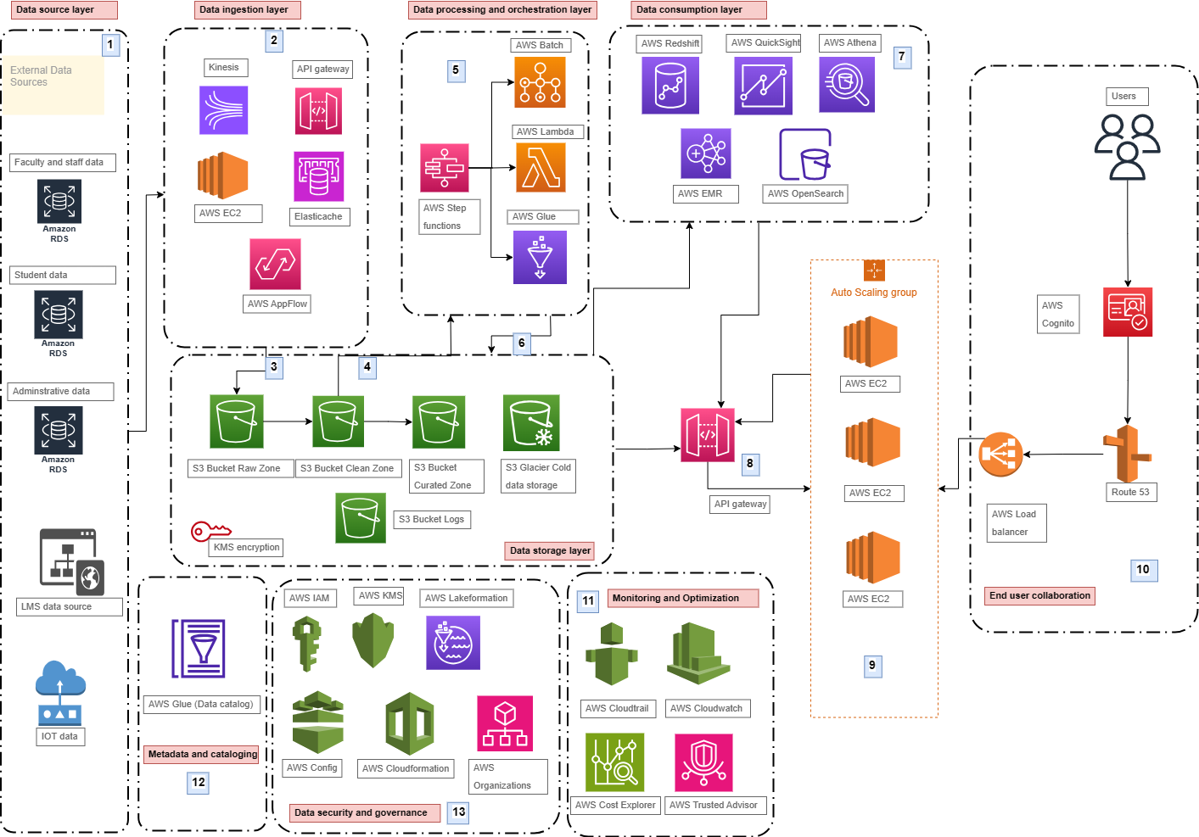
Cloud solution : Architecture

Slide 9
Addressing bottlenecks and optimization plans
Bottlenecks:
Horizontal Vs. Vertical scaling
Database partitioning and sharding
Caching strategies
Optimizations:
Multi-AZ deployment
S3 data life cycle policies
Intelligent pricing : S3 and EC2
CAP theorem

Slide 10
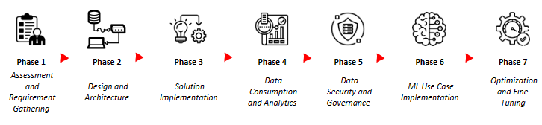
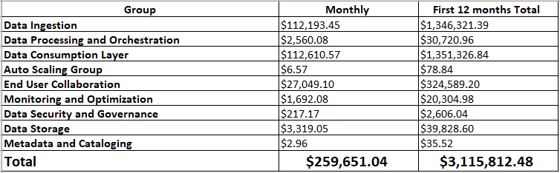
Implementation plan and cost estimation
4 weeks
4 weeks
8 weeks
6 weeks
4 weeks
6 weeks
Post implementation
10

Slide 11
AI/ML use cases
Predictive Analytics for Student Success
Alumni Donation Prediction
Identifying students at risk (dropouts, failures, financial or similar hardship)
Gauging effectiveness of staff and curriculum
Segmentation for student services/counselor organizations
Sales/marketing insights and alerts

Slide 12
Conclusion
We started with a comprehensive evaluation of the university's existing data landscape by closely looking at how the university deals with data today, understanding data types, and the data sources.
2 kinds of solutions providing the university more flexibility in choosing the architecture
The modern data strategy (Data lakehouse) forms the core of efficient data management, incorporating scalable data lakes, performance optimization, serverless architecture, unified data access, and machine learning integration
Optimization Techniques and Enhancements to address bottlenecks
Implementation plans and costs involved (first 12 months and monthly costs)
The proposed solution provides transformative vision for the university's data infrastructure—a harmonious blend of existing reliability and the dynamism of cloud-based solutions. This sets the stage for a modern, scalable, and secure foundation, primed for future advancements in data management and analytics.

Slide 13
References
https://aws.amazon.com/blogs/big-data/build-a-lake-house-architecture-on-aws/
https://docs.aws.amazon.com/wellarchitected/latest/analytics-lens/batch-data-processing.html
https://aws.amazon.com/caching/database-caching/
https://aws.amazon.com/getting-started/decision-guides/analytics-on-aws-how-to-choose/
Transitioning objects using Amazon S3 Lifecycle - Amazon Simple Storage Service
Sharding with Amazon Relational Database Service | AWS Database Blog
Horizontal scaling - AWS Well-Architected Framework (amazon.com)
CAP theorem - Availability and Beyond: Understanding and Improving the Resilience of Distributed Systems on AWS (amazon.com)
Data encryption - Amazon Redshift
Encrypt Your Amazon Redshift Loads with Amazon S3 and AWS KMS | AWS Big Data Blog
AWS Glue DataBrew now provides detection and data masking transformations for Personally Identifiable Information (PII) (amazon.com)
Efficient Infrastructure Management with AWS CloudFormation | by Brandon Damue | AWS in Plain English
https://aws.amazon.com/blogs/architecture/overview-and-architecture-building-customer-data-platform-on-aws/
https://aws.amazon.com/solutions/case-studies/Universidad-Francisco-de-Vitoria-UFV-case-study/?did=cr_card&trk=cr_card
https://aws.amazon.com/blogs/big-data/category/case-study/

Slide 14
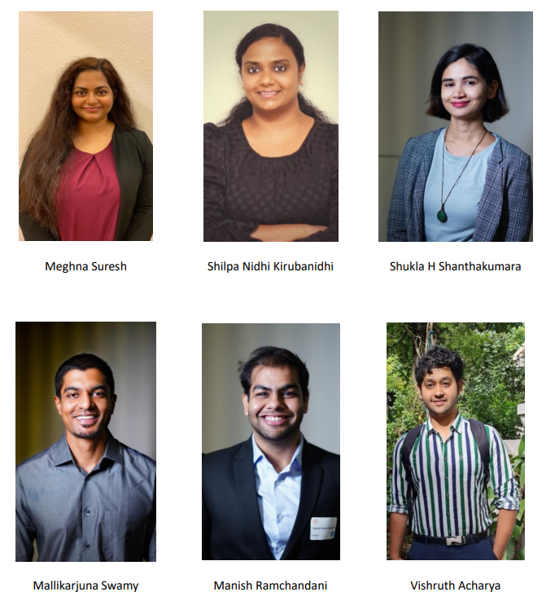
Project team

